Slide 1
Embedded Class 3
Compiler Tool Chain

Slide 2
Agenda
C Programming Language Background
Know your tools
Focus on knowing how to use tools
Compiler Tool Chain
Preprocessor
Compilers
Linker
Make and makefiles
Eclipse
Where are tool chain settings
Build options

Slide 3
C Programming Background
Invented by Dennis Ritchie in 1972
C was invented to write an operating system called UNIX.
C is a successor of B language which was introduced around 1970
The language was formalized in 1988 by the American National Standard Institute (ANSI).
By 1973 UNIX OS almost totally written in C.
Today C is the most widely used System Programming Language.
C standard is always changing, C18 is latest, C2x is coming
https://en.wikipedia.org/wiki/C18_(C_standard_revision)

Slide 4

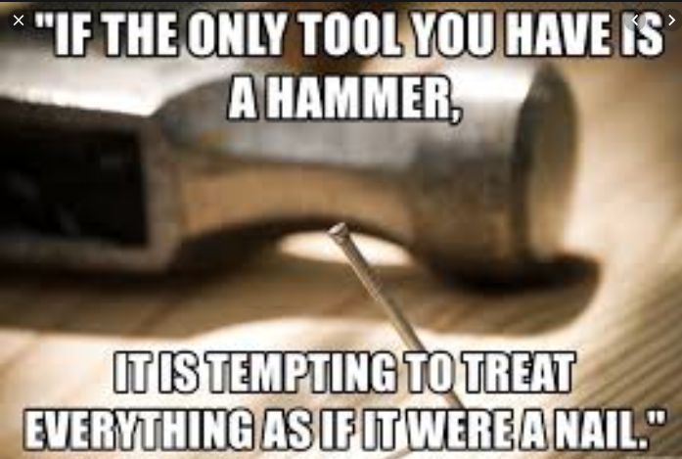
Know your Tools
How do you build a house?
We are going to focus today on tools
C syntax is something you can learn from book, or youtube.
We will have advance class later on C issues and problems
Every C/C++ program follow as defined path through some tools to create machine code.

Slide 5
Code Generation Path
For each source code file
Source Code
Green is your input
Orange is output files
Preprocessor
Assembler
C Compiler
C++ Compiler
Object Files
Map file
Listing file
Linker
Linker Script
Machine Code

Slide 6
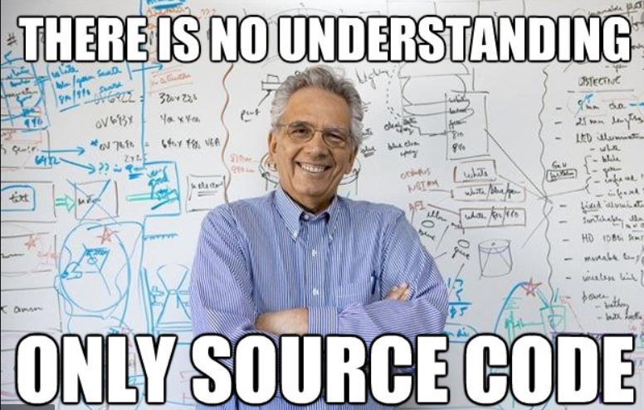
Source Code
Source Code
This can be C/C++ or Assembly
This is code you write

Slide 7
Preprocessor
Preprocessor
Programmers are Lazy and create a way to write Macros
#include, #define, etc are macros which are processed by the preprocessor.
Different compilers use different macro processors
The preprocessor is it’s own command line tool ( *cpp.exe)
You can pass preprocessor commands as command line options
Does everyone know what is meant by command line options?
There are lots of pre defined macros
__LINE__ __FILE__ __DATE___ __TIME__, etc
https://gcc.gnu.org/onlinedocs/cpp/

Slide 8
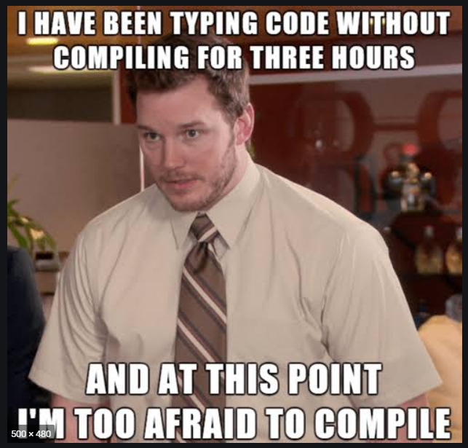
Compilers/Assemblers
Assembler
C Compiler
C++ Compiler
Converts your source code to object files
Compilers are command like tools
as
gcc
g++
There are lots of options for compiler, most can be changed with command line parameters
You can send some commands to compiler in code, for example:
Pragmas
__attributes__
Etc.

Slide 9
Object Files
Object Files
Each source file produces one object file
One to one mapping
Contains relocatable machine code
All address (SRAM and FLASH) are not fixed (relocatable)
Contains debug information

Slide 10
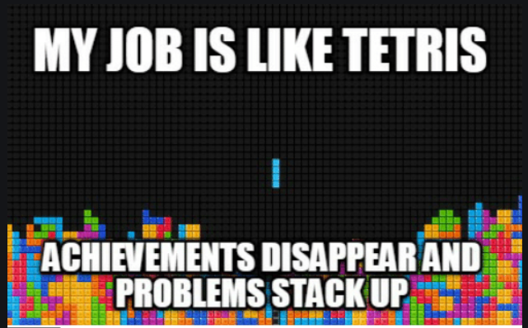
Linker
Map file
Listing file
Linker
Linker Script
Machine Code
Linker takes object files and plays tetris to get code into fixed memory locations
Linker Script/File tells Linker what memory sections to use
Map and Listing file are text file telling you where things are.

Slide 11
Linker Script
SECTIONS
{
. = 0x10000;
.text : { *(.text) }
. = 0x8000000;
.data : { *(.data) }
.bss : { *(.bss) }
}
‘SECTIONS’ is a key word to define the memory sections
‘.’ is the location counter
text section is constant data, including code and constants.
data is initialization data for variables
bss (block start by symbol) is uninitialized data (think ‘better save space’ for variables)

Slide 12
Class 2 linker script
Go through linker script from class 2
Go through map file
Go through listing file

Slide 13
Homework
Read/watch tutorial on Makefiles
Read about the command line options for GCC
What option do you enable in GCC to warn about variable assignments in if statements?
Go through a C programming language tutorial online
Build the class #2 example on the command line, without using eclipse
Extra Credit: Write a makefile by hand for the class #2 example

Slide 14
Notes
I debated on making this class fun, decided not to.
Getting something working quickly is a good high but provides frustration long term.
The fun will come when you have real confidence, and debate on philosophical issues not on the mechanics (compiler, linker, build tools).
Teaching C programming language is hard, and time consuming.
I expect everyone to watch some tutorials online and teach themselves
As we do examples and if you have questions I will answer them
Toward end of classes we will do a class on C and learn some of the pitfalls
The mechanics (compiler, linker, IDE, debugger) is where most people have the most initial problems.
IDEs make this problem much much worse

Slide 15
Next Few Classes
Make and Makefiles
This will be a whole class about make files
Grokking Code
Lets learn how to understand someone else code
Walk through an example and say what is good and bad and why.
Peripheral Driver Writing
We will create an example that writes to UART
We will read datasheet and figure out how to make it work step by step.
Embedded Philosophy
Error reporting, debugging and logging
Test Driven Development
Continuous Integration
Version control
Embedded Pitfalls
Heap and Malloc
Race Conditions
Stack faults
Watch Dog timers
Mutex and Threads
We will demonstrate race conditions
We will write mutex/semaphores
Bootloader
We will make a bootloader for your board
C verse C++
We will write the UART driver as C++ class
RTOS Concepts
Tasks
Kernel
MSP/PSP
RTOS implementation
We will roll our own RTOS

